Slide 1

Identifying Biases in Current Technology Designs and Solutions for Inclusivity
By Dr Shamsa Munir

Slide 2
Identify any biases in current technology designs that may exclude certain user groups? How can they be addressed?

Slide 3
Answer
Technology designs can sometimes exhibit biases that unintentionally exclude certain user groups.
These biases arise from assumptions, limited perspectives, or a lack of representation during the design and development process.
For sustainable and participatory design, recognizing these biases is crucial to creating inclusive technologies that serve diverse communities.
Below are common types of biases in technology design and strategies to address them, along with examples.

Slide 4
Common types of biases in technology design
1. Cultural Bias
2. Gender Bias
3. Disability Bias
4. Socioeconomic Bias
5. Age Bias

Slide 5

1. Cultural Bias
Many technologies are designed with a specific cultural context in mind, often rooted in Western norms, values, and practices. This can exclude users from different cultural backgrounds, leading to issues like language barriers, misaligned interfaces, or content that doesn't reflect their experiences.
Example:
Voice Assistants (e.g., Siri, Alexa) often struggle with understanding non-Western accents or names that are uncommon in the regions where the technology was developed. This can limit the functionality for users from different linguistic backgrounds.

Slide 6
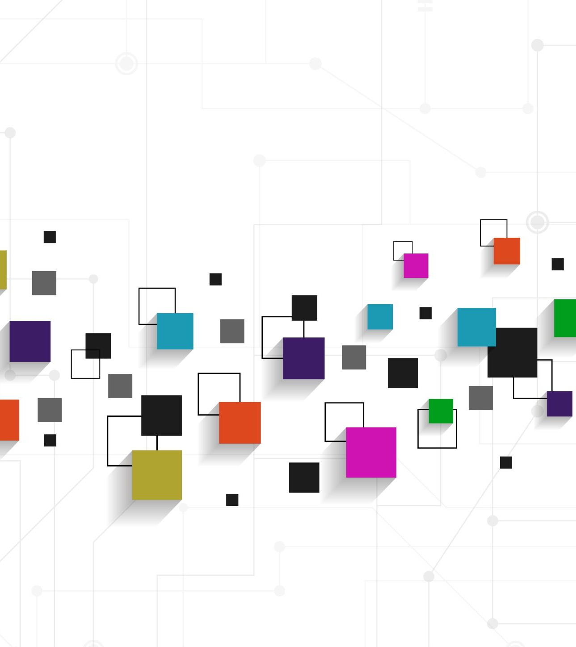
Solution:
Localizing Technology: Design should incorporate localized content, interfaces, and options that consider diverse languages, dialects, and cultural practices. This requires involving local communities in the design process to ensure that the technology reflects their needs.
Participatory Design: Engaging users from different cultural backgrounds during the testing and development phases can help identify and correct cultural mismatches in technology.

Slide 7
2. Gender Bias
Gender bias in technology design can manifest through stereotyping, unequal representation, or a failure to consider the needs and experiences of different genders.
Products may often be designed with a default male user in mind, neglecting the preferences or requirements of women and gender minorities.
Example:
Health Apps: Many fitness trackers or health applications are designed without accounting for women's specific health concerns. This results in limited tracking options for women compared to men.

Slide 8
Solution:
Inclusive Design: Incorporate gender-sensitive data and research into the design process. For example, health tracking apps could provide specific features tailored to different gendered health needs.
Diverse Development Teams: Ensure diversity within the development teams to include gender perspectives and expertise, leading to more gender-balanced design considerations.

Slide 9
3. Disability Bias
Many technologies fail to account for users with disabilities, limiting accessibility. This includes physical, cognitive, visual, auditory, and motor impairments, where users may face challenges interacting with hardware, software, or online platforms.
Example:
Websites with Poor Accessibility: Many websites do not offer features like screen reader compatibility, keyboard navigation, or alternative text for images, excluding people with visual or motor impairments.

Slide 10

Solution:
Universal Design Principles: Adopt accessibility standards such as the Web Content Accessibility Guidelines (WCAG) to make digital platforms more inclusive. This includes providing features like voice navigation, screen reader support, adjustable font sizes, and alternative input methods (e.g., voice, gestures).
Co-design with Users with Disabilities: Engaging users with disabilities in the design process can reveal barriers that might not be obvious to non-disabled developers.

Slide 11

4. Socioeconomic Bias
Technologies are often designed with the assumption that users have access to high-speed internet, expensive devices, or specific software, which can exclude people from lower socioeconomic backgrounds or those in developing countries.
Example:
E-Learning Platforms: Many online learning tools assume that students have uninterrupted access to high-speed internet and modern devices, excluding students in rural or low-income areas where connectivity or access to technology is limited.

Slide 12
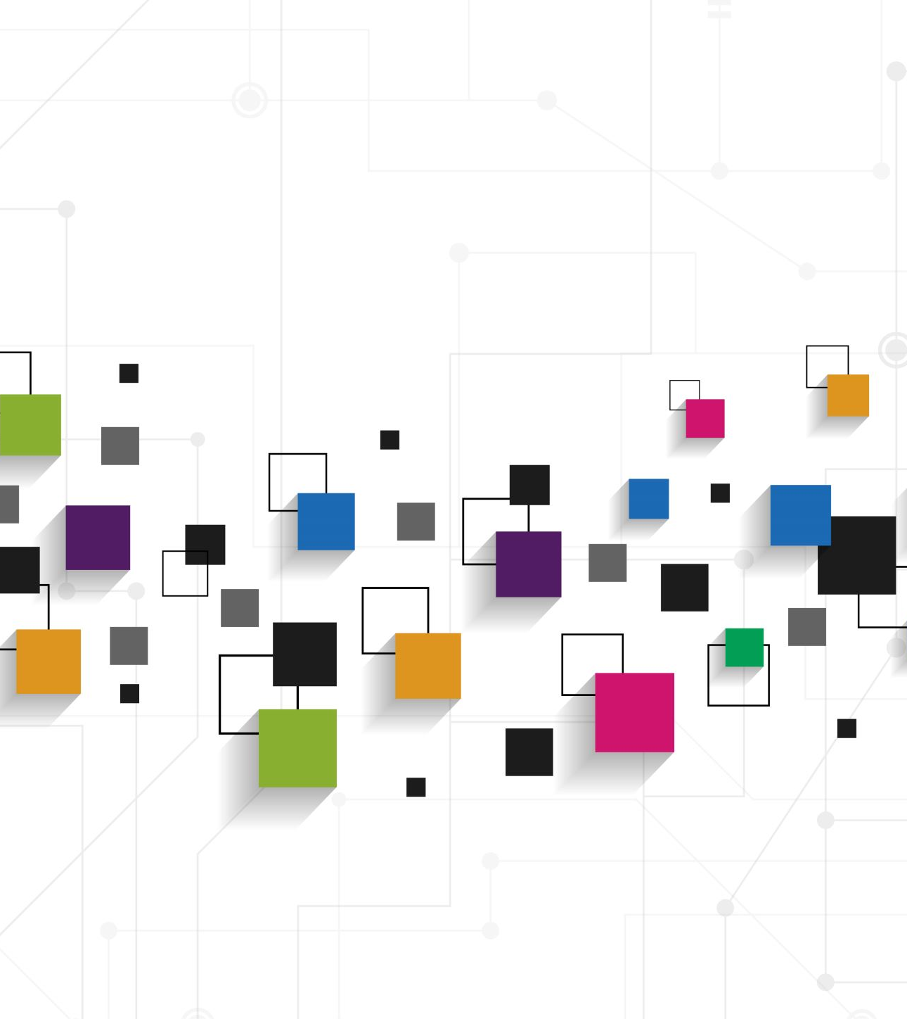
Solution:
Design for Low-Resource Settings: Technology should account for low-bandwidth scenarios, offer offline modes, or be optimized for older or lower-cost devices. For example, mobile applications that work offline or require minimal data usage can ensure wider access.
Partnership with Local Communities: Co-develop solutions that meet the unique needs of low-income or resource-constrained communities. This could involve creating lightweight applications that do not rely on constant internet access.

Slide 13
5. Age Bias
Many technologies, particularly digital interfaces and devices, are designed with younger users in mind, neglecting the needs of older adults who may have different physical or cognitive abilities and may be less familiar with rapidly evolving technologies.
Example:
Smartphones: Most smartphones are designed with small fonts, complex interfaces, and touch screens that may be difficult for elderly users to navigate, especially those with limited vision or reduced motor skills.

Slide 14

Solution:
Age-Friendly Design: Ensure that technologies are user-friendly for people of all ages by including larger fonts, simpler interfaces, and voice-activated commands.
Devices could also offer customization options for older users, such as simplified modes and intuitive help guides.
User Testing with Older Adults: Involving older users in testing can help identify specific issues they face and provide insights into how to make technology more age-inclusive.

Slide 15

Conclusion:
Biases in technology design can exclude certain user groups, leading to unequal access and missed opportunities for social inclusion.
By applying sustainable design principles and fostering participatory design processes, these biases can be addressed.
Engaging diverse user groups, conducting inclusive research, and testing across different demographics are crucial steps toward ensuring technology serves everyone equitably.
Sustainable and participatory design not only make products more inclusive but also contribute to building technologies that can be adapted and scaled to different communities, promoting long-term societal well-being.

